Slide 1
Learning Agile and Dynamic Motor Skills for Legged Robots
Jemin Hwangbo, Joonho Lee, Alexey Dosovitskiy, Dario Bellicoso, Joonho Lee, Vassilios Tsounis, Vladlen Koltun, and Marco Hutter
Presented by Steven Mazzola
UNI: slm2242

Slide 2
Why Legged Robots?
Good alternative to wheeled robots for rough terrain or otherwise complicated environments
Can perform similar actions to humans or other animals
Leg length increases obstacle avoidance and climbing ability

Slide 3
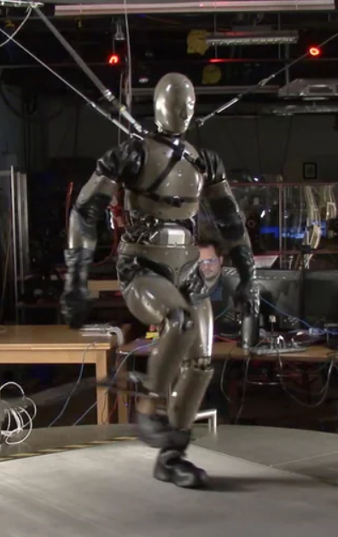
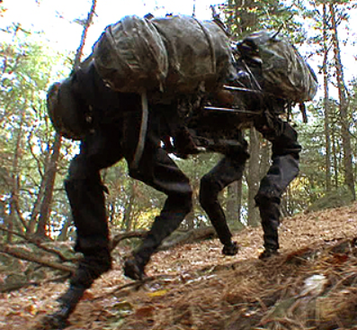
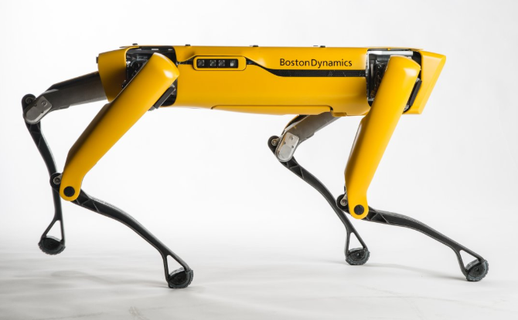
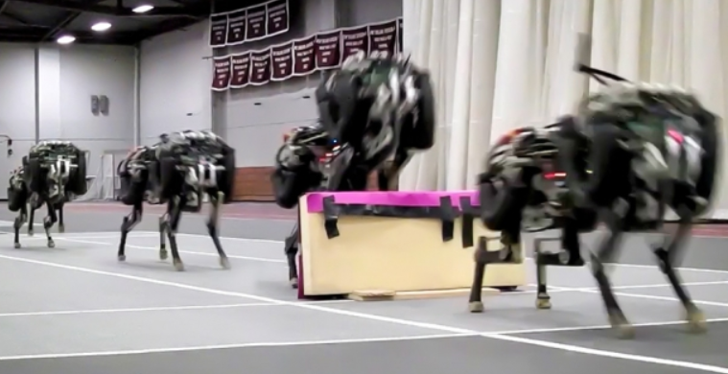
Boston Dynamics BigDog (hydraulic actuator)
Boston Dynamics SpotMini
(electric actuator)
Boston Dynamics PETMAN
(hydraulic actuator)
MIT Cheetah
(electric actuator)

Slide 4
What's wrong with current systems?
Hydraulic actuator robots (PETMAN, BigDog)
Advantage: uses conventional fuel, high energy output for size
Disadvantages:
Noisy and produces smoke. Cannot be used indoors without special accomodations
Heavy and large. Limits robot to large size
Electric actuator robots (Cheetah, SpotMini)
Cheetah: optimized mostly for speed, lacks general application capabilities
SpotMini: inner working are kept secret

Slide 5
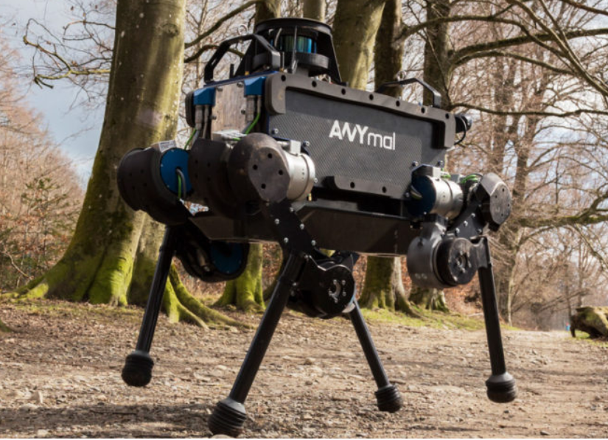
ANYmal Robot
Bio-inspired dog-sized quadruped
Weight: 32 kg
4 legs, 55cm long, 3 degrees of freedom
High leg-length to footprint ratio
12 Series-Elastic Actuators (SEAs)
Electric motor
High gear ratio transmission
Elastic element
Rotary encoders
Spring deflection
Output position

Slide 6
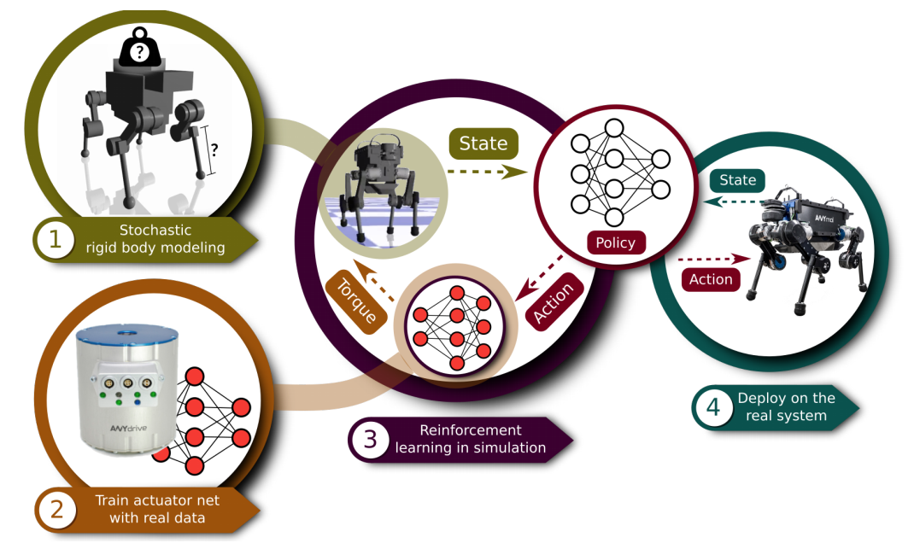
Methodology

Slide 7
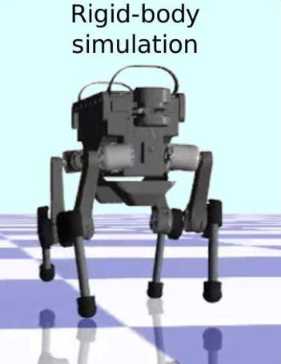
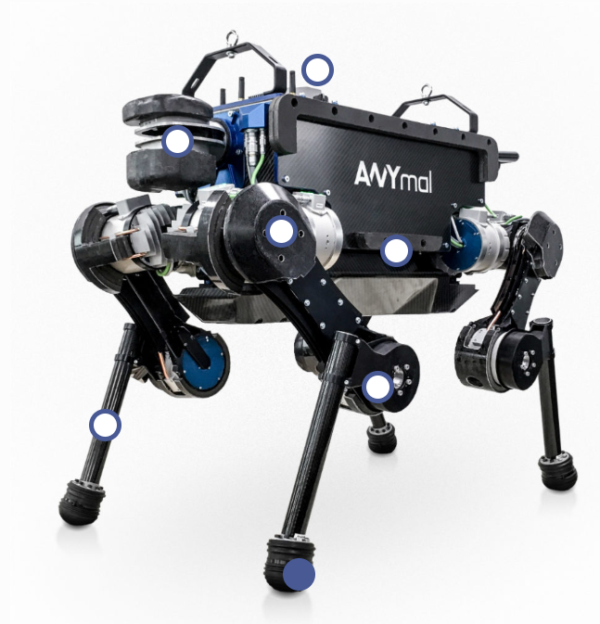
1. Modeling
ANYbot is composed of rigid links and ball bearings at the joints.
Would a fully ideal model representation be sufficient?
What aspects would be difficult to model?
Inertial properties
Actuator dynamics

Slide 8
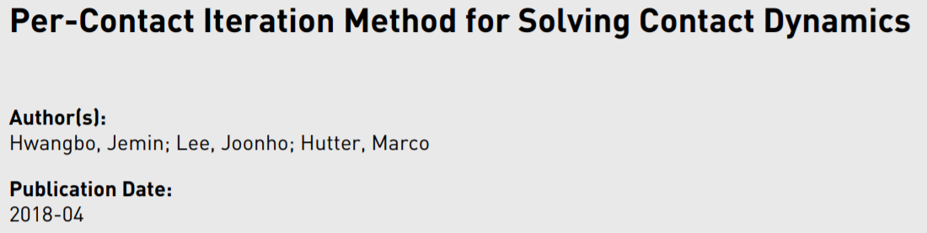
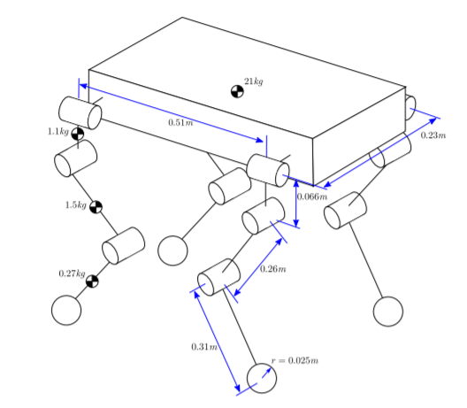
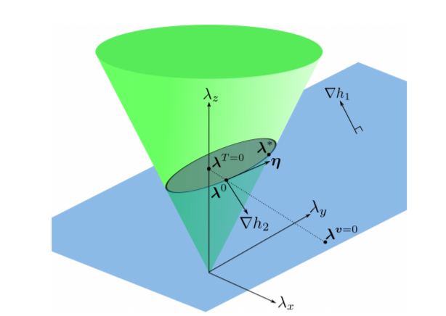
1. Modeling

Slide 9
2. Training
Actuators have non-linear dynamics and complex internal states
Self-supervised learning can be used to determine the action-to-torque relationship through an actuator network
Network uses history of position errors and velocity
Current state and past two states at 0.01s interval
Interval is sparse to prevent overfitting but dense enough to capture high frequency dynamics
Tuned with validation error
Trained by generating foot trajectories, computing expected joint positions with inverse kinematics, and collecting error between predicted and real data.

Slide 10
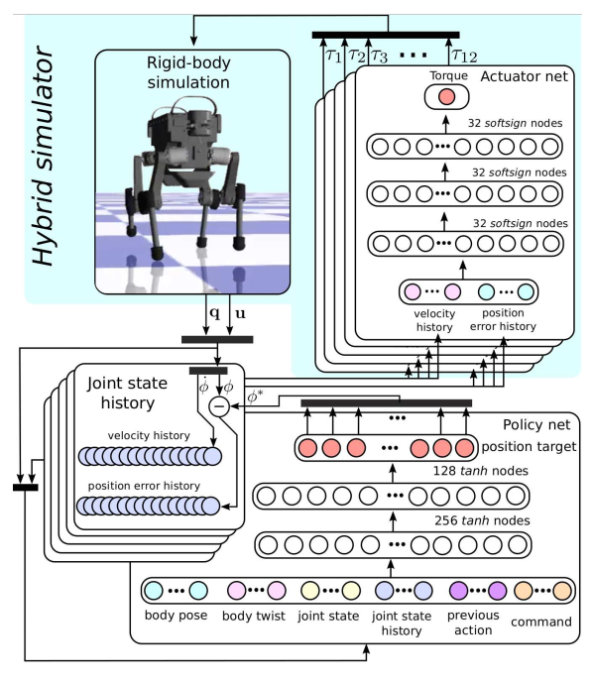
2. Training
Multi-layer perception (MLP) actuator network
3 hidden layers of 32 units each
Softsign activation function

Slide 11
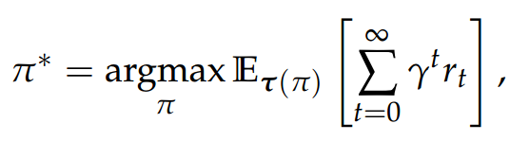
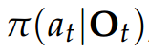
3. Learning
Observation o(t): state measurement of robot
Includes nine measurements: base orientation, base height, linear velocity, angular velocity, joint position, joint velocity, joint state history, previous action, command
Locomotor training uses all nine, while recovery training omits base height
Action a(t): position command to actuator
Selected according to stochastic policy
Uses a fixed PD controller
Kp set at value which keeps relative ranges of position and torque similar
Kd set at high value to reduce oscillation
Reward r(t): factor to promote desired behavior

Slide 12
3. Learning
Multi-layer perception (MLP) actuator network
2 hidden layers of 256 and 128 units
Tanh activation function
Trust Region Policy Optimization (TRPO)
Custom implementation allows for 250,000 state transitions in 4 hours
Stop if no performance improvement in 300 iterations

Slide 13
3. Learning
Need to find a balance for joint torque and velocity penalties
Low penalty: unnatural motions
High penalty: standing bias, limited movement
Curriculum:
Learn primary objective first, then refine movement for other criteria
Curriculum factor in range [0,1] added to all non-primary terms
For locomotion, base velocity error cost is unaffected
For recovery, base orientation cost is unaffected

Slide 14
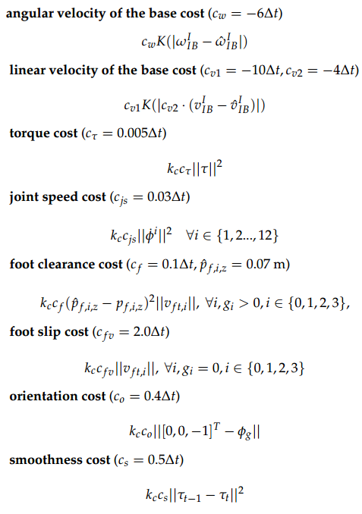
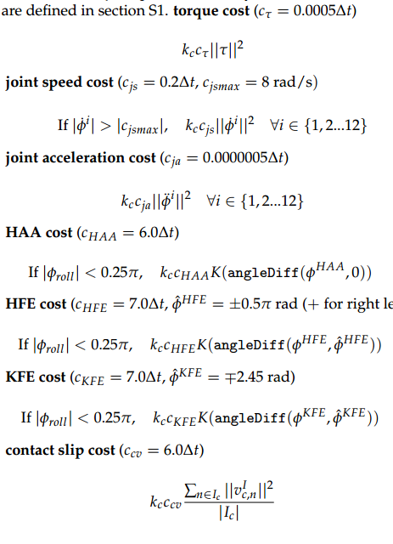
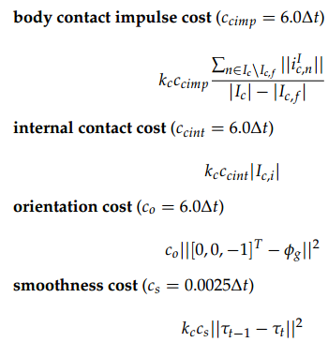
Locomotion
Recovery

Slide 15
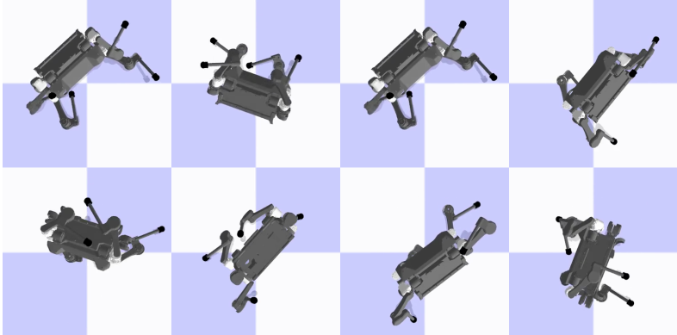
3. Learning
High-speed locomotion training:
Send randomly sampled forward, lateral, and turning velocities as commands
Trajectory executed for 6 seconds
Simulation terminated if in violation of ground or other limits
Training time: 4 hours
Recovery training:
Robot collision bodies are given random sizes and positions
Dropped from 1 meter in random configurations
Simulation runs for 1.2 seconds and result is set as initial position for learning
Training time: 11 hours

Slide 16
4. Deployment
Trained parameters set by simulation are now ported to onboard PC
Position commands converted to torque commands to control real robot
Complexity of actuators complicate this transfer

Slide 17
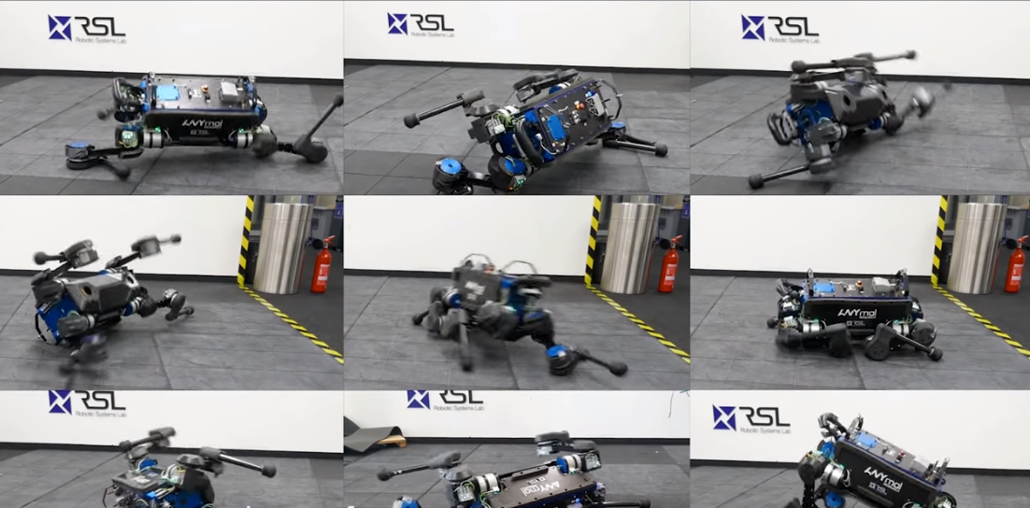
Video
https://www.youtube.com/watch?v=aTDkYFZFWug&feature=youtu.be

Slide 18
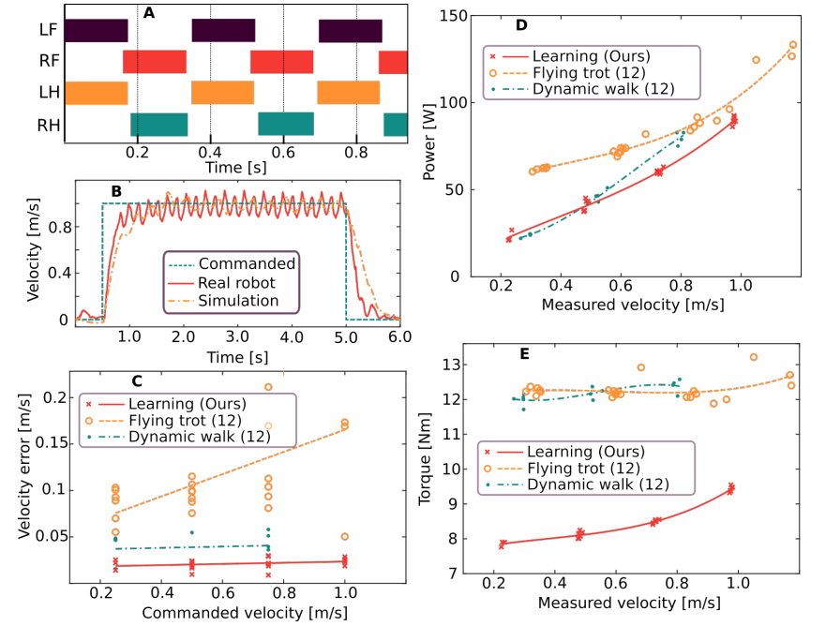
Results
Locomotion policy:
A: Discovered gait for 1.0m/s forward velocity
B: Comparison of base velocity tracking accuracy for different gaits
C,D,E:
Comparison between controllers for different gaits

Slide 19
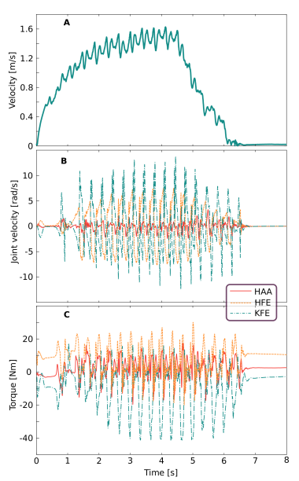
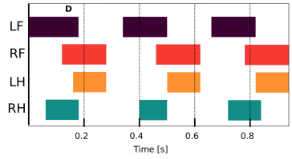
Results
High speed policy:
A: Forward velocity
B: Joint velocities
C: Joint torques
D: Gait pattern

Slide 20
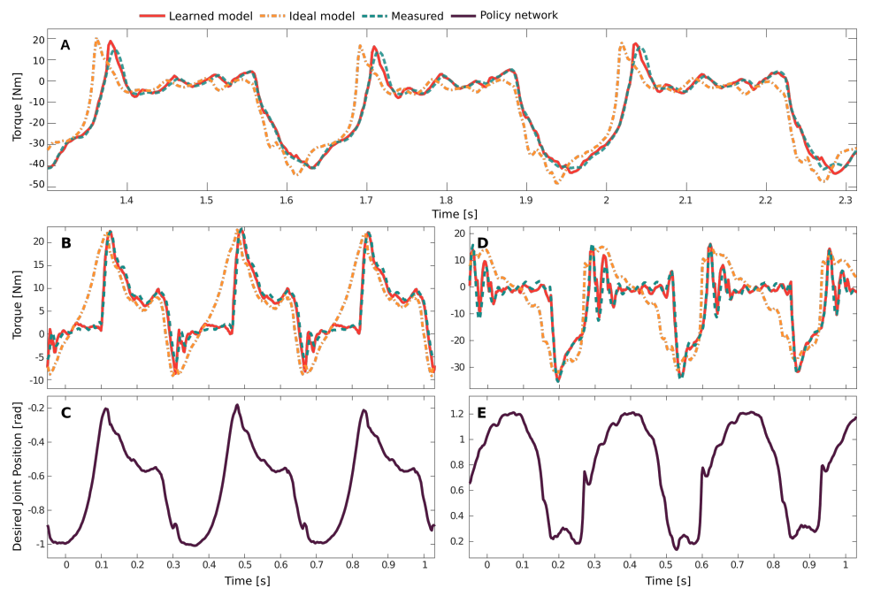
Results
Actuation validation:
A: Validation set
B,C: 0.75m/s forward velocity
D,E: 1.6m/s forward velocity

Slide 21
So what was achieved?
ANYmal gained locomotion skills derived purely from a simulated training environment on an ordinary computer.
Locomotion tests outperformed previous speed record on the ANYmal by 25%
Recovery rate was 100% after tuning joint velocity constraints, even in complex initial configurations
The simulation and learning framework created in this research can be roughly applied to any rigid body system

Slide 22
Additional References
Thank you!
ANYmal: https://www.anybotics.com/anymal-legged-robot/
BostonDynamics: https://www.bostondynamics.com
MIT: http://biomimetics.mit.edu/

